Slide 1
IMO Model Course on
Oil Pollution Preparedness, Response and Cooperation
Level 3 - The Strategic Level
Exercise 3.5
Incident Management Systems (IMS)

Slide 2
Objective
Discuss and identify an appropriate incident management structure for your organization/country/region.
Identify agencies and stakeholders that should be part of your IMS.

Slide 3
Instructions
The class will be randomly divided into a maximum of 5 groups
Each group to discuss if the suggested IMO incident management structure is appropriate for your needs.
Populate the various IMS functions
    Command
    Planning
    Operations
    Logistics
    Finances

Slide 4
Instructions
Results will be discussed in plenary
20-minute group discussion
25-minute plenary session
Questions?

Slide 5
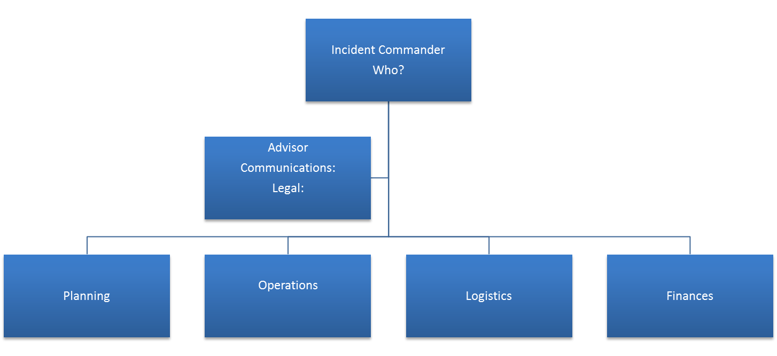
IMS

Slide 6
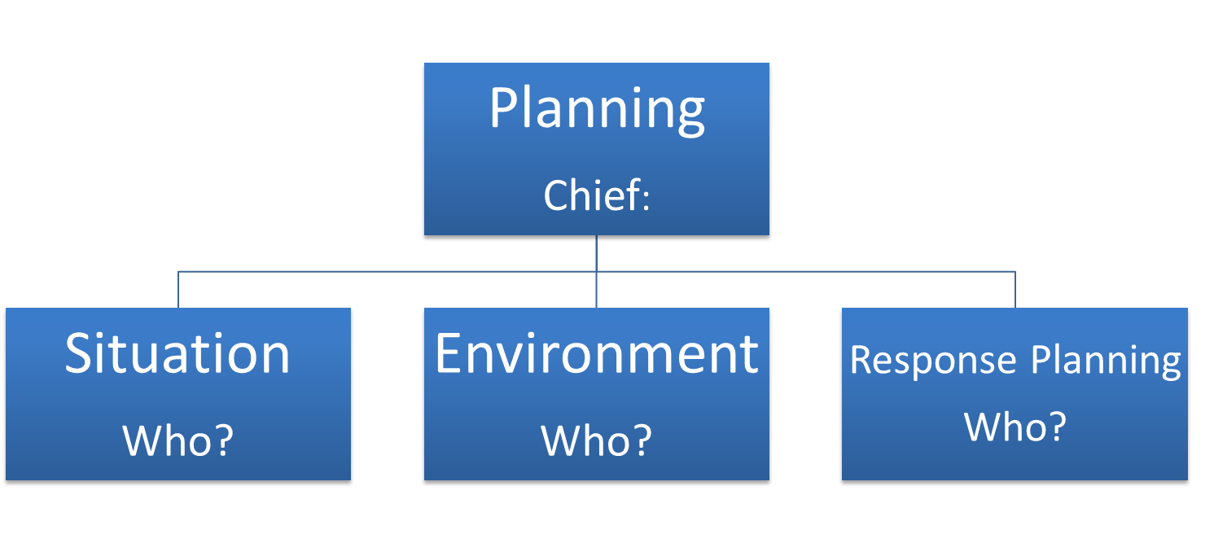
IMS

Slide 7
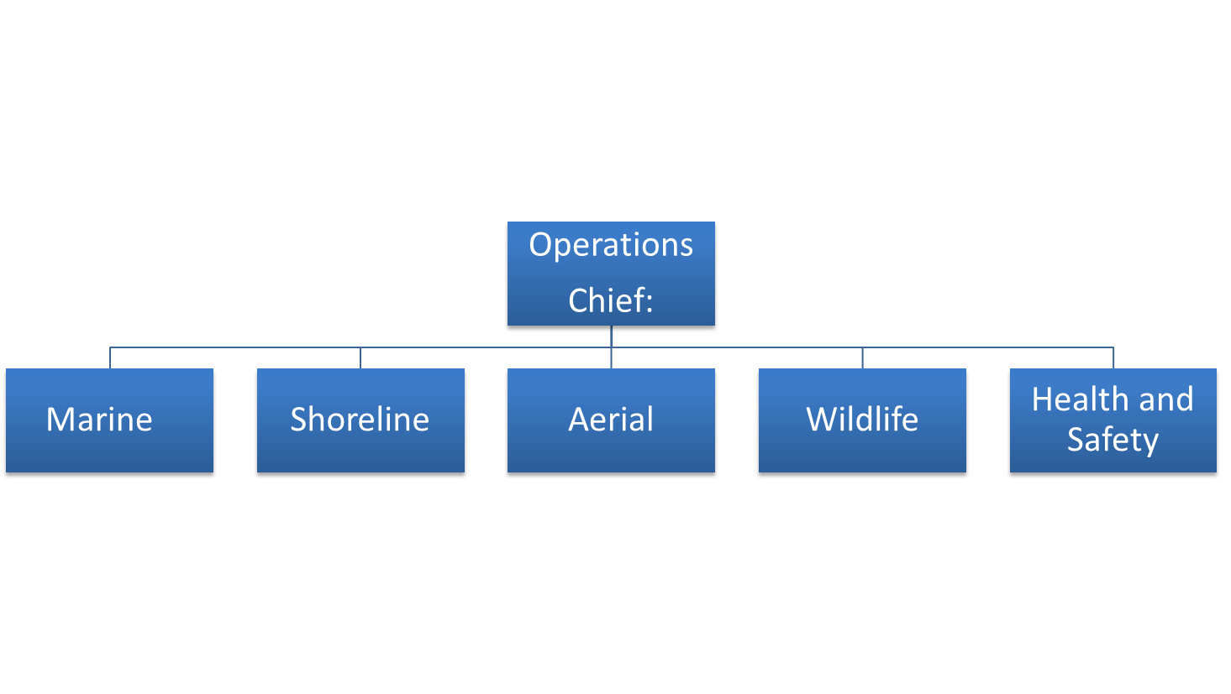
IMS

Slide 8
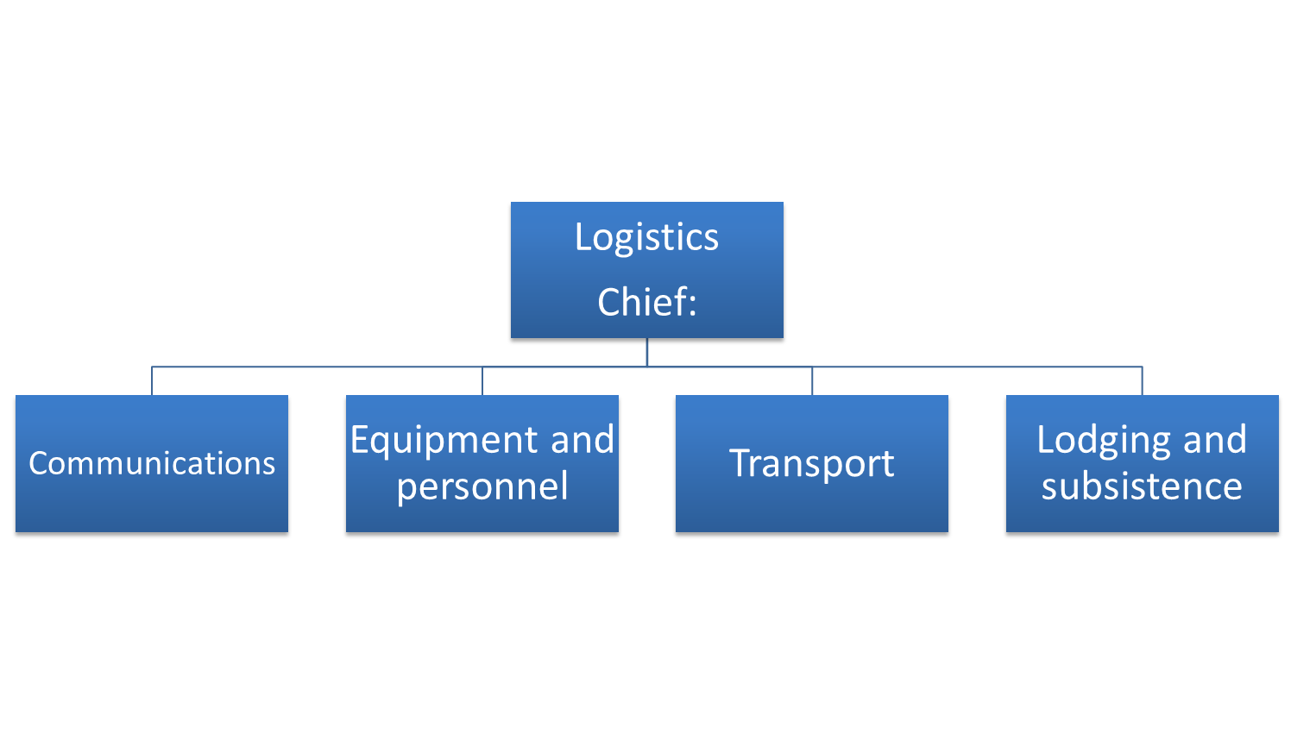
IMS

Slide 9
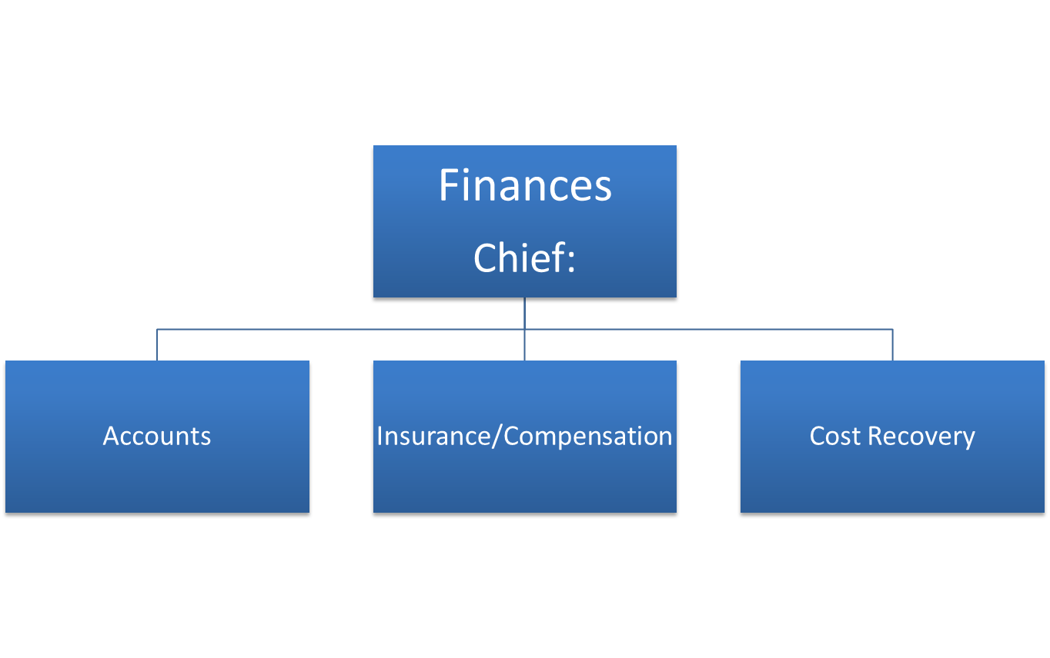
IMS

